Slide 1
Week 2 Internship Report
SAP FICO Configuration – A Step-by-Step Guide
Prepared as part of the SAP FICO Internship with Yuva Intern Student Name: Ashish Kumar | Roll Number: 25SCS1003003125
Course / Department: B.Tech (CSE) | College / University: IILM University Greater Noida
Internship Organisation: Yuva Intern | Internship Title: SAP FICO Internship
Week: 2 | Submission Date: 06/09/2026

Slide 2
Table of Contents
This report covers the key concepts I studied during Week 2 of my SAP FICO internship. It is organised to build understanding progressively — from basic definitions to how different parts of SAP FICO work together in a real business scenario.
01 02 03
Introduction
What SAP is, what FICO means, and why configuration matters
Understanding SAP FICO Configuration
Configuration vs customisation, master data, and transaction data
Basic Concepts Before Configuration
Client, company code, chart of accounts, fiscal year, and more
04
05
06
SAP FICO Enterprise Structure
Defining companies, company codes, and controlling areas
Financial Accounting Configuration
General Ledger, accounts payable, accounts receivable, and asset accounting
Controlling Configuration
Cost centres, profit centres, and internal orders
07
08
09
FI–CO Integration & Module Integration
How FI and CO work together and connect with other SAP modules
End-to-End Scenario, Challenges & Best Practices
ABC Electronics case study, common problems, and practical guidance
ECC vs S/4HANA, Learning Outcomes & Conclusion
Version differences, what I learned, and next steps

Slide 3

Introduction
SAP is one of the most widely used enterprise software systems in the world. It helps organisations manage their business processes — from finance and accounting to human resources and supply chain — in a single integrated system. SAP stands for Systems, Applications, and Products in Data Processing, and it is used by large companies across industries globally.
SAP FICO is one of the core modules of SAP. FICO stands for Financial Accounting (FI) and Controlling (CO). FI handles external financial reporting — things like balance sheets, profit and loss statements, and managing accounts with customers and suppliers. CO handles internal management accounting — tracking costs, budgets, and profitability within the organisation. Together, they form the financial backbone of any SAP implementation.
SAP configuration means setting up the SAP system to match a specific organisation's business requirements. Every company is different — they have different departments, currencies, tax rules, payment methods, and reporting needs. Configuration is how we tell SAP to work the way that particular business needs it to work. It is not the same as writing code or changing the software itself. Configuration uses the tools and settings that SAP already provides.
Business Requirement s
SAP
Configuratio n
Master Data
Business Transactions
FI and CO Processing
Understanding configuration is important for someone learning SAP FICO because it is the foundation on which all financial transactions and reports are built. Without proper configuration, the system cannot process transactions correctly or produce accurate financial reports. During this internship week, I focused on building a conceptual understanding of how SAP FICO is configured and why each step matters.

Slide 4
Understanding SAP FICO Configuration
Before diving into specific configuration steps, it is important to understand what configuration actually means in the SAP context, and how it differs from other concepts that are often confused with it.
What is Configuration?
Configuration is the process of setting up SAP using its built-in settings to match a business's specific requirements. It is done through the SAP Implementation Guide (IMG), which is SAP's official framework for configuration activities.
Configuration vs Customisation
Configuration uses standard SAP settings — no programming is required. Customisation involves changing or extending SAP's standard functionality through development work (ABAP programming).
Configuration should always be tried first; customisation should only be used when standard SAP cannot meet a specific business requirement.
For example, when we create a company code in SAP, we are configuring the system — we are telling SAP that this organisation exists and defining its financial reporting structure.
Configuration vs Master Data
Configuration sets up the structure of the system (e.g., defining account groups). Master data is the business information stored within that structure (e.g., customer records, vendor records). Configuration is done once during implementation; master data is created and maintained continuously during day-to-day operations.
Concept | Meaning | Example
Configuration | Setting up SAP according to business requirements | Creating a company code
Master Data | Long-term business information | Customer or vendor record
Transaction Data | Data created during business activities | An invoice or payment
Customisation | Adapting SAP beyond standard settings | Configuring a unique payment procedure
Functional consultants play an important role in SAP configuration. They work with business teams to understand requirements, then translate those requirements into SAP configuration settings. After configuration, thorough testing is essential — any error in configuration can lead to incorrect financial data, which affects decision-making at every level of the organisation.

Slide 5
Basic Concepts Before Configuration
Before starting any SAP FICO configuration, there are several fundamental concepts that every beginner must understand. These concepts form the organisational and structural foundation of the entire SAP system. Without a clear understanding of these, it is difficult to make sense of configuration steps or understand why they are required.
1 | Client The highest level in the SAP system hierarchy. A client is a self-contained unit with its own master data and configuration. Large organisations may have multiple clients for different purposes (e.g., development, testing, production).
2 | Company A legal entity or group of companies. In SAP, a company is an organisational unit used for consolidated financial reporting across multiple company codes.
3 | Company Code The central organisational unit in Financial Accounting. It represents an independent legal entity for which complete financial statements (balance sheet, profit and loss) are prepared. Every business transaction in FI is recorded at the company code level.
4 | Controlling Area The central organisational unit in Controlling (CO). It is used for internal cost and profitability reporting. One controlling area can serve one or more company codes, allowing cross-company cost analysis.
5 | Chart of Accounts A complete list of all General Ledger accounts used by a company. It defines the structure and numbering of accounts. Every company code must be assigned to a chart of accounts.
6 | Fiscal Year & Posting Period The fiscal year defines the 12-month (or other period) financial year for a company. Posting periods are the individual months or periods within the fiscal year during which transactions can be recorded. SAP allows you to control which periods are open for posting.
Financial Transactions
Postings and journal entries
General Ledger
Central accounting ledger
Chart of Accounts
List of general ledger accounts
Company Code
Legal entity for financials
SAP Client
Top-level system environment
It is also important to understand the relationship between FI and CO structures. The Company Code is the primary unit for Financial Accounting (FI), while the Controlling Area is the primary unit for Controlling (CO). These two structures must be properly assigned to each other for FI–CO integration to work correctly. A company code can only be assigned to one controlling area, but a controlling area can serve multiple company codes.

Slide 6
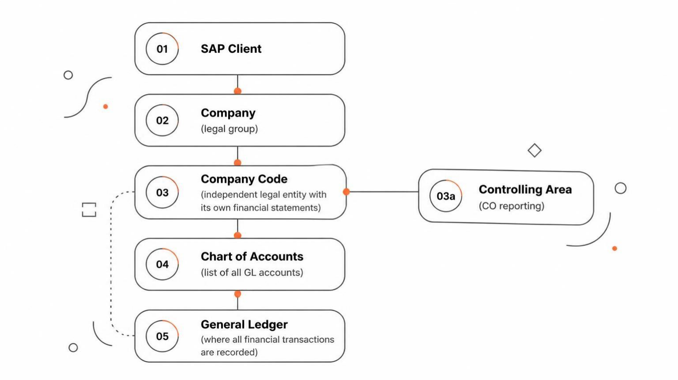
SAP FICO Enterprise Structure
The enterprise structure is the organisational framework within SAP. It defines how a business is represented in the system
— its legal entities, reporting units, and operational divisions. Configuring the enterprise structure is always the first step in any SAP FICO implementation because all other configuration depends on it.
1 2
Define Company
Create the legal entity or group that will be represented in SAP. The company is used for consolidated financial reporting across multiple company codes.
Define Company Code
Create the individual legal entity for which financial statements are prepared. Each company code has its own currency, fiscal year, and chart of accounts.
3
4
Assign Company Code to Company
Link the company code to its parent company for consolidated reporting purposes.
Define & Assign Controlling Area
Create the controlling area for internal cost reporting and assign company codes to it for FI–CO integration.
Why Company Code is Critical
The company code is the most important organisational unit in SAP FI. All financial transactions — invoices, payments, journal entries — are recorded at the company code level. Financial statements such as the balance sheet and profit and loss account are prepared for each company code. A company must have at least one company code, and each company code must have a unique four-character identifier.
Controlling Area Assignment
The controlling area is assigned to one or more company codes. This assignment is required so that costs recorded in FI can be automatically passed to CO for internal reporting. The controlling area must share the same fiscal year variant and currency as the company codes assigned to it (or use currency translation).

Slide 7
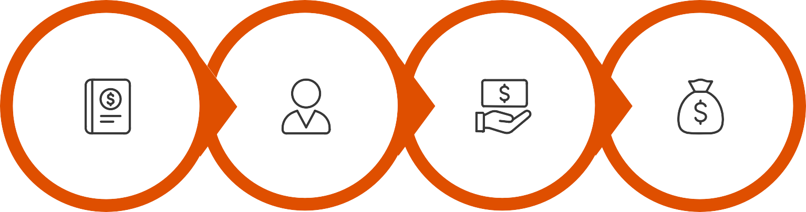
Financial Accounting (FI) Configuration
Financial Accounting configuration sets up all the areas within SAP FI. This includes the General Ledger, Accounts Payable, Accounts Receivable, and Asset Accounting. Each area has its own configuration requirements, but they all share the same foundational enterprise structure. Below is a summary of the key configuration areas.
FI Area | Key Configuration Elements | Purpose
General Ledger (G/L) | Chart of Accounts, Account Groups, G/L Accounts, Document Types, Number Ranges, Posting Periods, Field Status, Financial Statement Structure | Record all financial transactions and produce external financial reports
Accounts Payable (AP) | Vendor Account Groups, Reconciliation Accounts, Payment Terms, Payment Methods, Tolerance Settings | Manage money owed to suppliers and process outgoing payments
Accounts Receivable (AR) | Customer Account Groups, Reconciliation Accounts, Payment Terms, Dunning Procedures | Manage money owed by customers and process incoming payments
Asset Accounting (AA) | Asset Classes, Depreciation Areas, Depreciation Keys, Useful Life | Track and manage fixed assets and their depreciation over time
Chart of Accounts
Configure G/L
Set Up AP/AR
Enable Asset Accounting
General Ledger Configuration
The General Ledger is the central record of all financial transactions. Configuration includes defining the chart of accounts (the list of all accounts), creating account groups (which control the number range and field status of accounts), and setting up document types and number ranges for different types of transactions. Posting periods are configured to control when transactions can be recorded, and field status settings determine which fields are required, optional, or hidden during data entry.
Accounts Payable & Receivable
AP configuration involves setting up vendor account groups, defining reconciliation accounts (G/L accounts that summarise all vendor balances), and configuring payment terms and methods. AR configuration is similar but for customers. Both areas use reconciliation accounts to ensure that subsidiary ledger balances (individual customer/vendor accounts) always match the corresponding G/L balances. This is a key control mechanism in SAP.

Slide 8



Accounts Payable, Accounts Receivable & Asset Accounting
These three areas handle the day-to-day financial relationships a company has with its suppliers, customers, and fixed assets. Understanding how they are configured helps explain how SAP tracks money flowing in and out of the business.
Accounts Payable Process
When a company receives goods or services from a supplier, a vendor invoice is recorded in SAP. The system posts the expense to the appropriate G/L account and updates the vendor's balance in the AP subsidiary ledger.
Payment terms determine when the payment is due. The automatic payment programme can then be run to process multiple payments at once. The financial impact: expenses increase, and the liability to the supplier is recorded until payment is made.
Accounts Receivable Process
When a company sells products or services to a customer, a customer invoice is created. SAP records the revenue in the G/L and updates the customer's balance in the AR subsidiary ledger. Payment terms specify when the customer must pay. If a customer pays late, the dunning process can be used to send reminder notices. Incoming payments are matched against open invoices, clearing the customer's balance.
Asset Accounting Process
When a company purchases a fixed asset (like machinery or a vehicle), an asset master record is created in SAP. The asset is assigned to an asset class, which determines its depreciation rules. Depreciation is calculated automatically based on the depreciation key and useful life. Over time, the asset's book value decreases. When the asset is retired or sold, SAP records the disposal and any gain or loss on the transaction.
AR Process
Customer Invoice → Accounts Receivable
→ Customer Payment
→ G/L Update
AP Process
Vendor Invoice → Accounts Payable → Payment → G/L Update
Asset Process
Asset Purchase → Acquisition → Depreciation → Asset Retirement

Slide 9
Controlling Configuration & FI–CO Integration
The Controlling (CO) module handles internal management accounting. While FI focuses on external financial reporting, CO focuses on internal cost tracking and profitability analysis. Both modules are tightly integrated — when a financial transaction is posted in FI, the relevant cost information is automatically passed to CO in real time.
Controlling Area Configuration
The controlling area is the central unit in CO. It must be defined and company codes must be assigned to it. The controlling area determines the currency and fiscal year for all cost reporting. All cost centres, profit centres, and internal orders belong to a controlling area.
Cost Centre Accounting
Cost centres represent departments or functions within a company (e.g., Production, HR, Marketing). Cost centre configuration includes defining cost centre categories, creating a cost centre hierarchy, and setting up cost centre groups for reporting. Costs from FI transactions are automatically assigned to cost centres, allowing management to see how much each department is spending.
Profit Centres
Profit centres represent business units for which both revenues and costs are tracked. They enable profitability reporting by segment, product line, or region. Profit centres are assigned to cost centres and G/L accounts.
Internal Orders
Internal orders are used to track costs for specific projects, events, or temporary activities. They have a defined start and end, and costs collected on an internal order are eventually settled (transferred) to a cost centre or asset.
Cost Allocation
Cost allocation distributes costs from one cost centre to others. For example, the IT department's costs can be allocated to other departments based on usage. This is done through assessment or distribution cycles in SAP CO.
Business Transaction
Operational expense occurs
CO Receipt
Cost information sent to CO
Management Analysis
Review department costs
FI Recording
FI posts the expense
Cost Assignment
Assign cost to cost centre
Example: A company pays an electricity bill of ₹50,000 for its production department. In FI, the expense is recorded and the bank account is reduced. Simultaneously, in CO, the ₹50,000 cost is automatically assigned to the Production cost centre. Management can then analyse how much the production department is spending on utilities and make informed decisions about cost control.

Slide 10
Module Integration, End-to-End Scenario & Conclusion
SAP FICO does not work in isolation. It integrates with other SAP modules so that every business activity — purchasing, selling, manufacturing, payroll — has an automatic financial impact. The table below summarises the key integrations.
SAP Module | Business Activity | Financial Impact in FICO
MM (Materials Management) | Purchasing materials and goods | Inventory values and Accounts Payable
SD (Sales and Distribution) | Selling products to customers | Revenue and Accounts Receivable
PP (Production Planning) | Manufacturing products | Production costs recorded in CO
HCM / SuccessFactors | Payroll processing | Salary expenses in FI and CO
PM (Plant Maintenance) | Equipment maintenance | Maintenance costs in CO
End-to-End Scenario: ABC Electronics Pvt. Ltd.
To bring everything together, consider a fictional company
— ABC Electronics Pvt. Ltd., which manufactures electronic products. In SAP, the company would first define its organisational structure: one company code for the legal entity, one controlling area for cost reporting, and a chart of accounts for all financial transactions. G/L accounts would be created for assets, liabilities, revenues, and expenses. Cost centres would be set up for each department (Production, Sales, Admin), and profit centres for each product line. Vendors and customers would be created as master data. When ABC Electronics purchases raw materials, the MM module triggers an AP entry in FI and a cost entry in CO. When products are sold, SD triggers an AR entry and revenue posting. All of this flows automatically into financial statements and management reports.
Common Challenges & Best Practices
Beginners often face challenges such as incorrect organisational structure setup, wrong G/L account configuration, incorrect posting periods, and FI–CO integration errors. These can be prevented by thoroughly understanding business requirements before starting configuration, maintaining proper documentation, using development and testing environments before going live, and performing integration testing across all modules. It is also important to keep in mind the differences between SAP ECC and SAP S/4HANA — S/4HANA has a simplified data model with the Universal Journal, and configuration steps can vary by version and deployment type (cloud vs on-premise).
Company Setup
Company & company code
Controlling
Controlling area & cost centres
Integration & Reporting
FI-CO, reports, decisions
Master Data
Chart of accounts & G/L
Business Partners
Vendor and customer setup
Learning Outcomes — Week 2: Through research and study, I understood what SAP configuration means and how it connects business requirements to system behaviour. I learned how SAP enterprise structures are organised — particularly the role of company codes and controlling areas. I understood the basic configuration areas of FI (General Ledger, AP, AR, Asset Accounting) and CO (cost centres, profit centres, internal orders). I also understood how FI and CO integrate in real time, and how business transactions create financial impacts that flow into reports and management decisions. I now appreciate why testing and accurate master data are critical parts of any SAP implementation.
Conclusion: Week 2 of this internship has helped me establish a solid conceptual understanding of SAP FICO configuration. I now understand that configuration is what connects SAP to real business requirements, that FI handles external financial accounting while CO supports internal cost and profitability analysis, and that the enterprise structure provides the foundation for everything else. Correct configuration is essential for accurate transactions and reliable reports. The FI–CO integration makes SAP FICO particularly powerful for organisations because financial and management accounting work together seamlessly. In future weeks, I look forward to exploring practical exercises, transaction processing, reporting, and deeper learning of individual SAP FICO areas.
References
SAP Help Portal — help.sap.com
SAP Learning — learning.sap.com
SAP Official Documentation for SAP ECC and SAP S/4HANA Finance SAP Implementation Guide (IMG) — available within SAP systems

